Slide 1
第6课
使用决策结构
学习创建各种决策结构并学会判断哪些应用程序应使用决策结构。
条件结构
事件驱动编程

Slide 2
A. 条件结构
认识条件结构的基本特点和功能并学会使用。
复习条件结构
创建和配置条件结构
选择器接线端的数据类型
输入和输出隧道

Slide 3
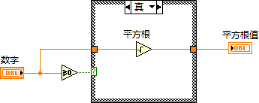
活动6-1
复习条件结构
选择器标签
选择器接线端

Slide 4
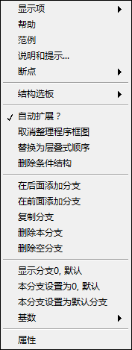
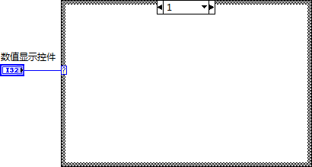
条件结构
创建和配置条件结构。

Slide 5
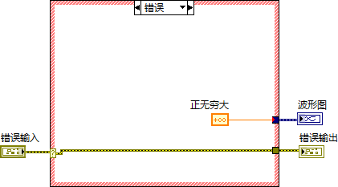
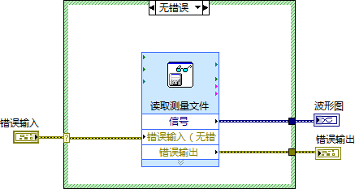
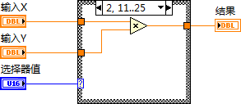
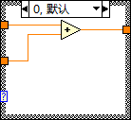
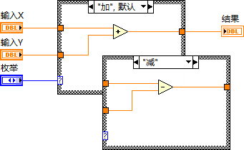
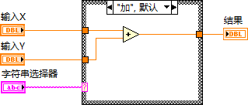
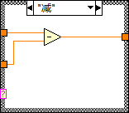
A. 条件结构
选择器接线端的数据类型

Slide 6
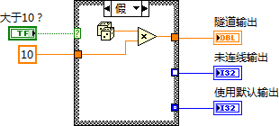
A. 条件结构
输入和输出隧道
输入隧道数据可供全部条件分支使用。
必须为每个条件分支定义其输出隧道。

Slide 7
选择器类型和隧道
创建使用不同数据类型选择器的条件结构。
创建不同类型的输出隧道。

Slide 8
练习6-1
温度警告（使用错误处理）
修改VI，使用条件结构实现软件决策。

Slide 9
练习6-1
温度警告（使用错误处理）
如所有的值都是10，会发生什么情况？如何修正？
是否已定义全部输出通道？如果有一个输出未定义，会发生什么情况？

Slide 10
B. 事件驱动编程
认识事件结构的基本特点和功能。
事件驱动场景
轮询 vs. 事件结构
事件驱动编程
配置事件结构
说明和建议

Slide 11
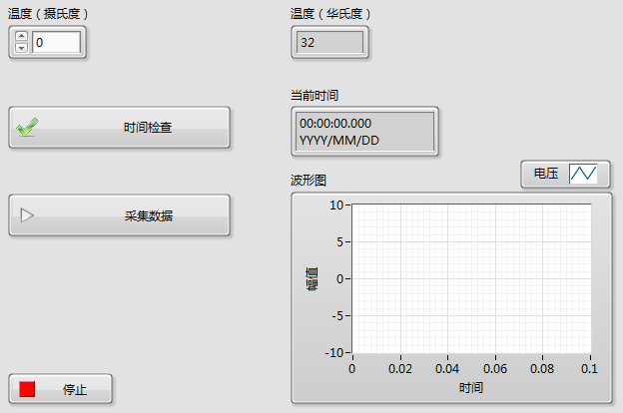
事件驱动场景
Notes:
Refer to Instructor Guide for demo instructions.

Slide 12
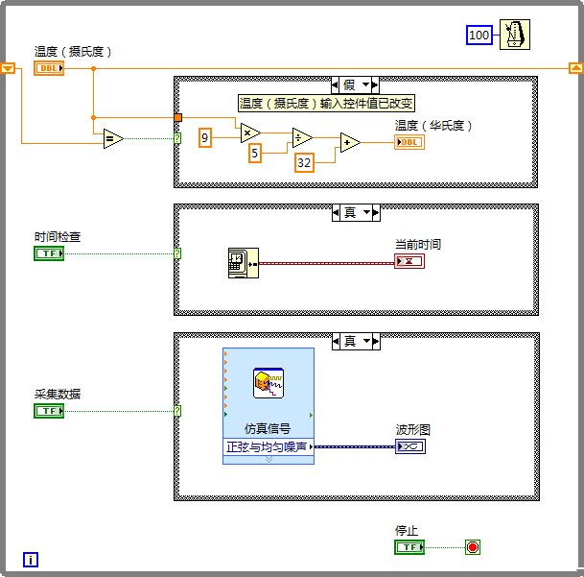
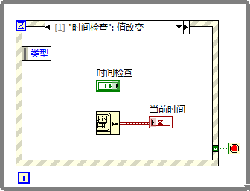
B. 事件驱动编程
轮询 vs. 事件结构
轮询
事件
Notes:
Polling
Method of event-based programming where a loop must continually run code to check if changes have occurred.
Polling the front panel requires a significant amount of CPU time.
Polling can fail to detect changes if they occur too quickly.
Event Structures
Events in Event structures eliminate the need to poll the front panel.
Benefits of using Event structures:
Reduces the CPU requirements of the program.
Simplifies the block diagram code.
Guarantees that the block diagram can respond to all interactions the user makes. Handles all events in the order they occur. Does not miss any events.
Event-driven programs usually include a loop that waits for an event to occur, executes code to respond to the event, and reiterates to wait for the next event.
Events allow you to execute a specific event-handling case each time a user performs a specific action. Without events, the block diagram must poll the state of front panel objects in a loop, checking to see if any change has occurred. Polling the front panel requires a significant amount of CPU time and can fail to detect changes if they occur too quickly. By using events to respond to specific user actions, you eliminate the need to poll the front panel to determine which actions the user performed. Instead, LabVIEW actively notifies the block diagram each time an interaction you specified occurs. Using events reduces CPU requirements of the program, simplifies the block diagram code, and guarantees that the block diagram can respond to all interactions the user makes.

Slide 13
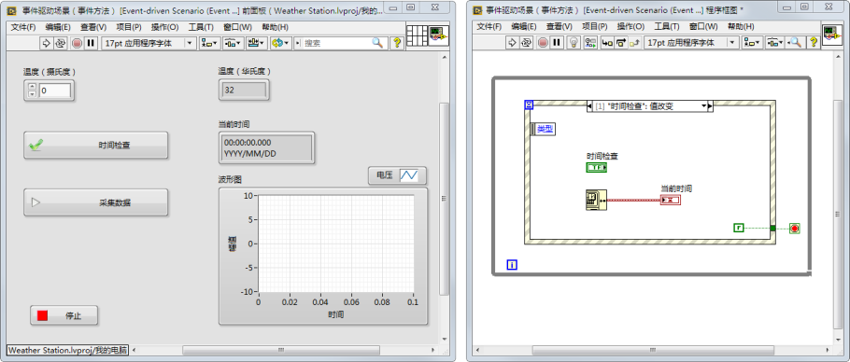
事件驱动编程

Slide 14
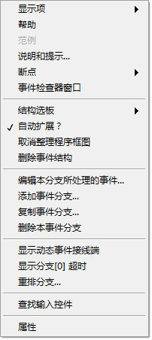
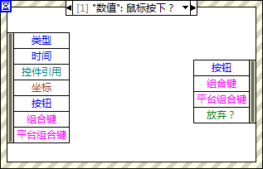
B. 事件驱动编程
配置事件结构
Notes:
Event Structure Configuration
You can select exactly which events will wake up your Event structure by right-clicking the border and selecting Edit Events Handled by This Case from the shortcut menu. This opens the Edit Events dialog box.

Slide 15
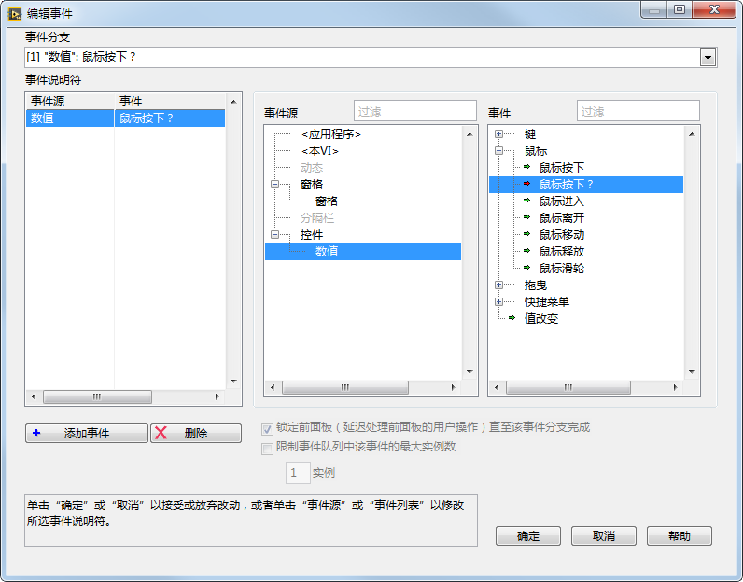
B. 事件驱动编程
编辑事件对话框
已配置的事件
事件
事件源
Notes:
The dialog box is divided into 3 panes.
Configured Events: The left-most pane shows the list of specific events the current event case (sub-diagram) is configured to handle, displayed as pairs of <event source, event type>.
Event Sources: The middle pane shows the event sources (classes) you can choose from, which include the Application, the current VI, all of the controls on the VI’s front panel, and dynamic events.
Events: The right-most pane shows the individual events that the currently selected source on the left can generate. Clicking on an item in the event source or event type lists immediately updates the highlighted entry under Event Specifiers.
Notice that mouse and key events can be generated by either the VI or a control. You can set up the event structure to pay attention to both. LabVIEW delivers the VI event first, generated for mouse or key activity anywhere on the front panel, and then the control event if the mouse was in a particular control or the control had keyboard focus.
You can configure a single diagram to handle more than one event. To do this, click the Add Event button to add a new entry in Event Specifiers, and then use the Event Sources and Events panes to select its source and type. To share an event case, events should have compatible event data. Only data which is common to all events handled by an event case will be available in its event data node on the left border of the structure.
An event with a green arrow is a notify event; an event with a red arrow is a filter event.

Slide 16
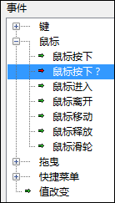
B. 事件驱动编程
通知事件和过滤事件
通知事件
（绿色箭头）
过滤事件（红色箭头）

Slide 17

配置和使用事件
演示：配置和使用事件结构。
Notes:
For the demonstration: Drop one or two controls on front panel, including a Stop button. On the block diagram, drop an Event structure in a While Loop. Configure the Event structure to respond to the front panel controls and then terminate using the Stop value change.
Describe the event registration as part of the demonstration.
Event Registration:
Collection of steps that happen behind the scenes to prepare the LabVIEW Event Handler to handle the event.
Event registration involves:
Allocation of memory to queue up events.
Spawning of pieces of code that run behind the scenes to catch events that happen. These pieces of code are called listeners or observers.
Key points:
LabVIEW registers events that you configure with the Edit Events dialog box.
When a registered event occurs, LabVIEW queues the event until the Event Handler executes.
It is not possible to miss events or process them out of order.
Events are unregistered when the VI becomes idle.

Slide 18
练习6-2
转换轮询设计为事件结构设计
将基于轮询的应用程序转换为基于事件的应用程序。

Slide 19
练习6-2
转换轮询设计为事件结构设计
轮询时循环运行多少次？
修改VI以使用事件结构时，循环运行了多少次？

Slide 20
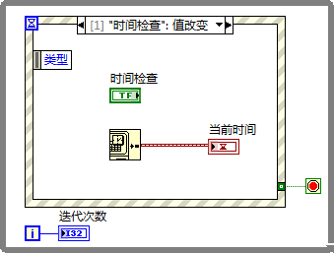
B. 事件驱动编程
说明和建议
一个循环中仅放置一个事件结构。
使用“值改变”事件检测值的改变。
保持事件处理代码简洁快速。
将布尔控件接线端置于事件分支的内部，以保证触发操作正常运行。
避免在循环外使用事件结构。
避免为同一个事件配置两个事件结构。
Notes:
For a complete list of Caveats and Recommendations, refer to LabVIEW Help topic: Caveats and Recommendations when Using Events in LabVIEW.
Avoid using an Event structure outside of a loop.
The Event structure handles only one event each time it executes.
Place only one Event structure in a loop.
If you place two Event structures in a single loop, the loop cannot iterate until both Event structures handle an event.
The loop can become unresponsive if two Event structures are in a single loop.
Avoid configuring two Event structures to handle the same event.
Use a Value Change event to detect value changes.
Value Change events will generate events regardless of how the user modifies the control.
Examples of Value Change events are: Keyboard shortcut, increment/decrement arrow buttons, keyboard entry in digital display
The Value Change event is easier and more efficient than attempting to monitor keyboard and mouse actions for a given control.
Keep event handling code short and quick.
It is possible to lock the user interface if code takes too long to execute.
For the UI Event Handler to be effective, the event handling code for all events needs to be short and quick!
When you trigger an event on a Boolean control configured with a latching mechanical action, the Boolean control does not reset to its default value until the block diagram reads the terminal on the Boolean control. You must read the terminal inside the event case for the mechanical action to work correctly.

Slide 21

B. 事件驱动编程
思考您工作中需要开发的VI。
您会使用事件编程来实现该VI吗？
为什么？

Slide 22

活动6-2
课程回顾
参考学员指南回答本课所学内容的相关问题，并分组进行讨论。

Slide 23
课程回顾
下列哪一项不能用作条件结构的选择器输入？
错误簇
数组
枚举
字符串

Slide 24
课程回顾
下列哪一项不能用作条件结构的选择器输入？
错误簇
数组
枚举
字符串

Slide 25
课程回顾
事件结构每次执行时能处理多少事件？
自上次事件结构执行后发生的所有事件
每个已配置的事件分支处理一个事件
一个

Slide 26
课程回顾
事件结构每次执行时能处理多少事件？
自上次事件结构执行后发生的所有事件
每个已配置的事件分支处理一个事件
一个

Slide 27
课程回顾
下列关于事件驱动编程和轮询的说法，哪些是正确的？
事件按需执行。
事件驱动编程需要较少的CPU资源。
事件结构按事件发生的顺序处理事件。
轮询有时无法检测到变化。

Slide 28
课程回顾
下列关于事件驱动编程和轮询的说法，哪些是正确的？
事件按需执行。
事件驱动编程需要较少的CPU资源。
事件结构按事件发生的顺序处理事件。
轮询有时无法检测到变化。

